Slide 1
GENETICALLY MODIFIED CROPS

Slide 2
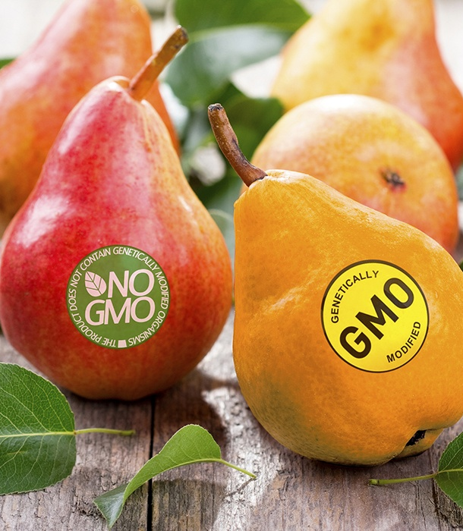
What is genetic modification (GM) of crops ?
GM is a technology that involves inserting DNA into the genome of an organism. To produce a GM plant, new DNA is transferred into plant cells. Usually, the cells are then grown in tissue culture where they develop into plants. The seeds produced by these plants will inherit the new DNA

Slide 3
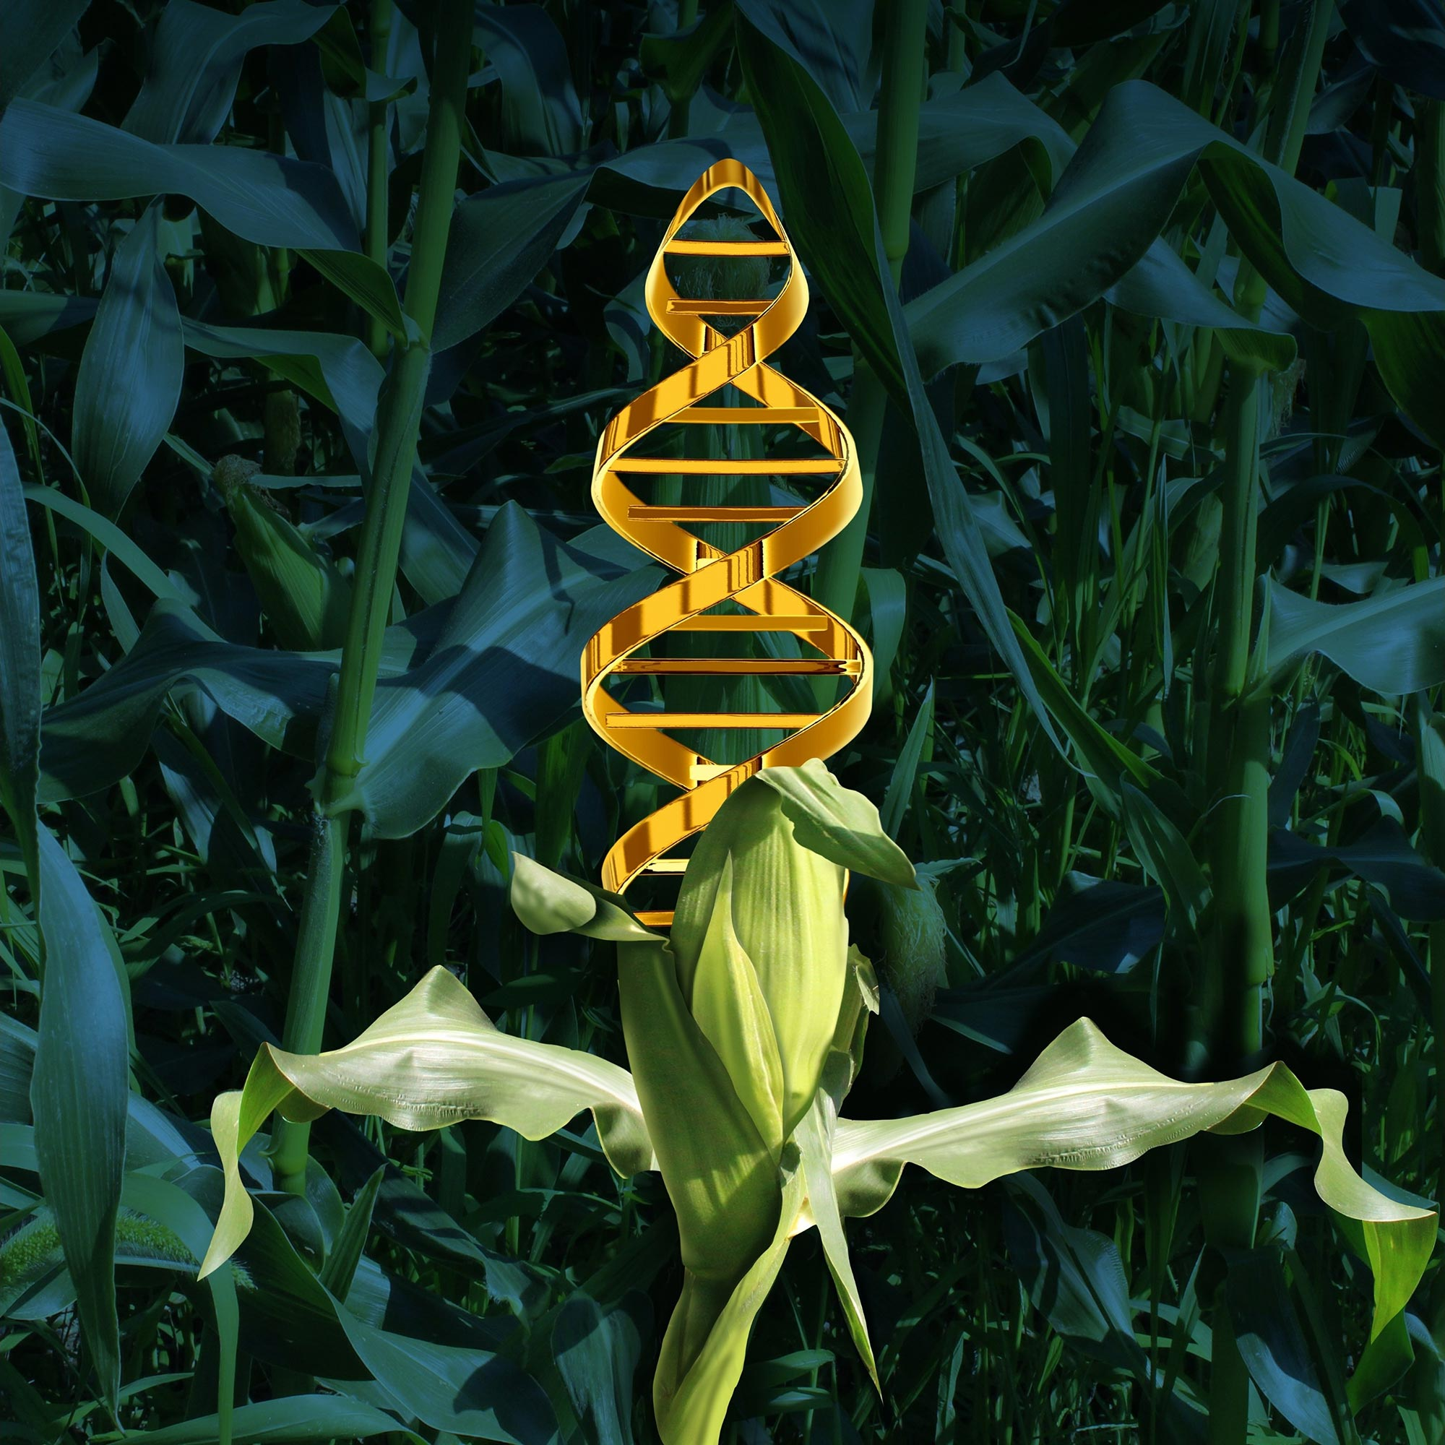
Genetic modification of plants involves adding a specific stretch of DNA into the plant’s genome, giving it new or different characteristics. This could include changing the way the plant grows or making it resistant to a particular disease. The new DNA becomes part of the GM plant’s genome which the seeds produced by these plants will contain.

Slide 4
Importance
Increased crop yields.
Reduced costs for food.
Drug production.
Reduced need for pesticides.
Greater food security.

Slide 5
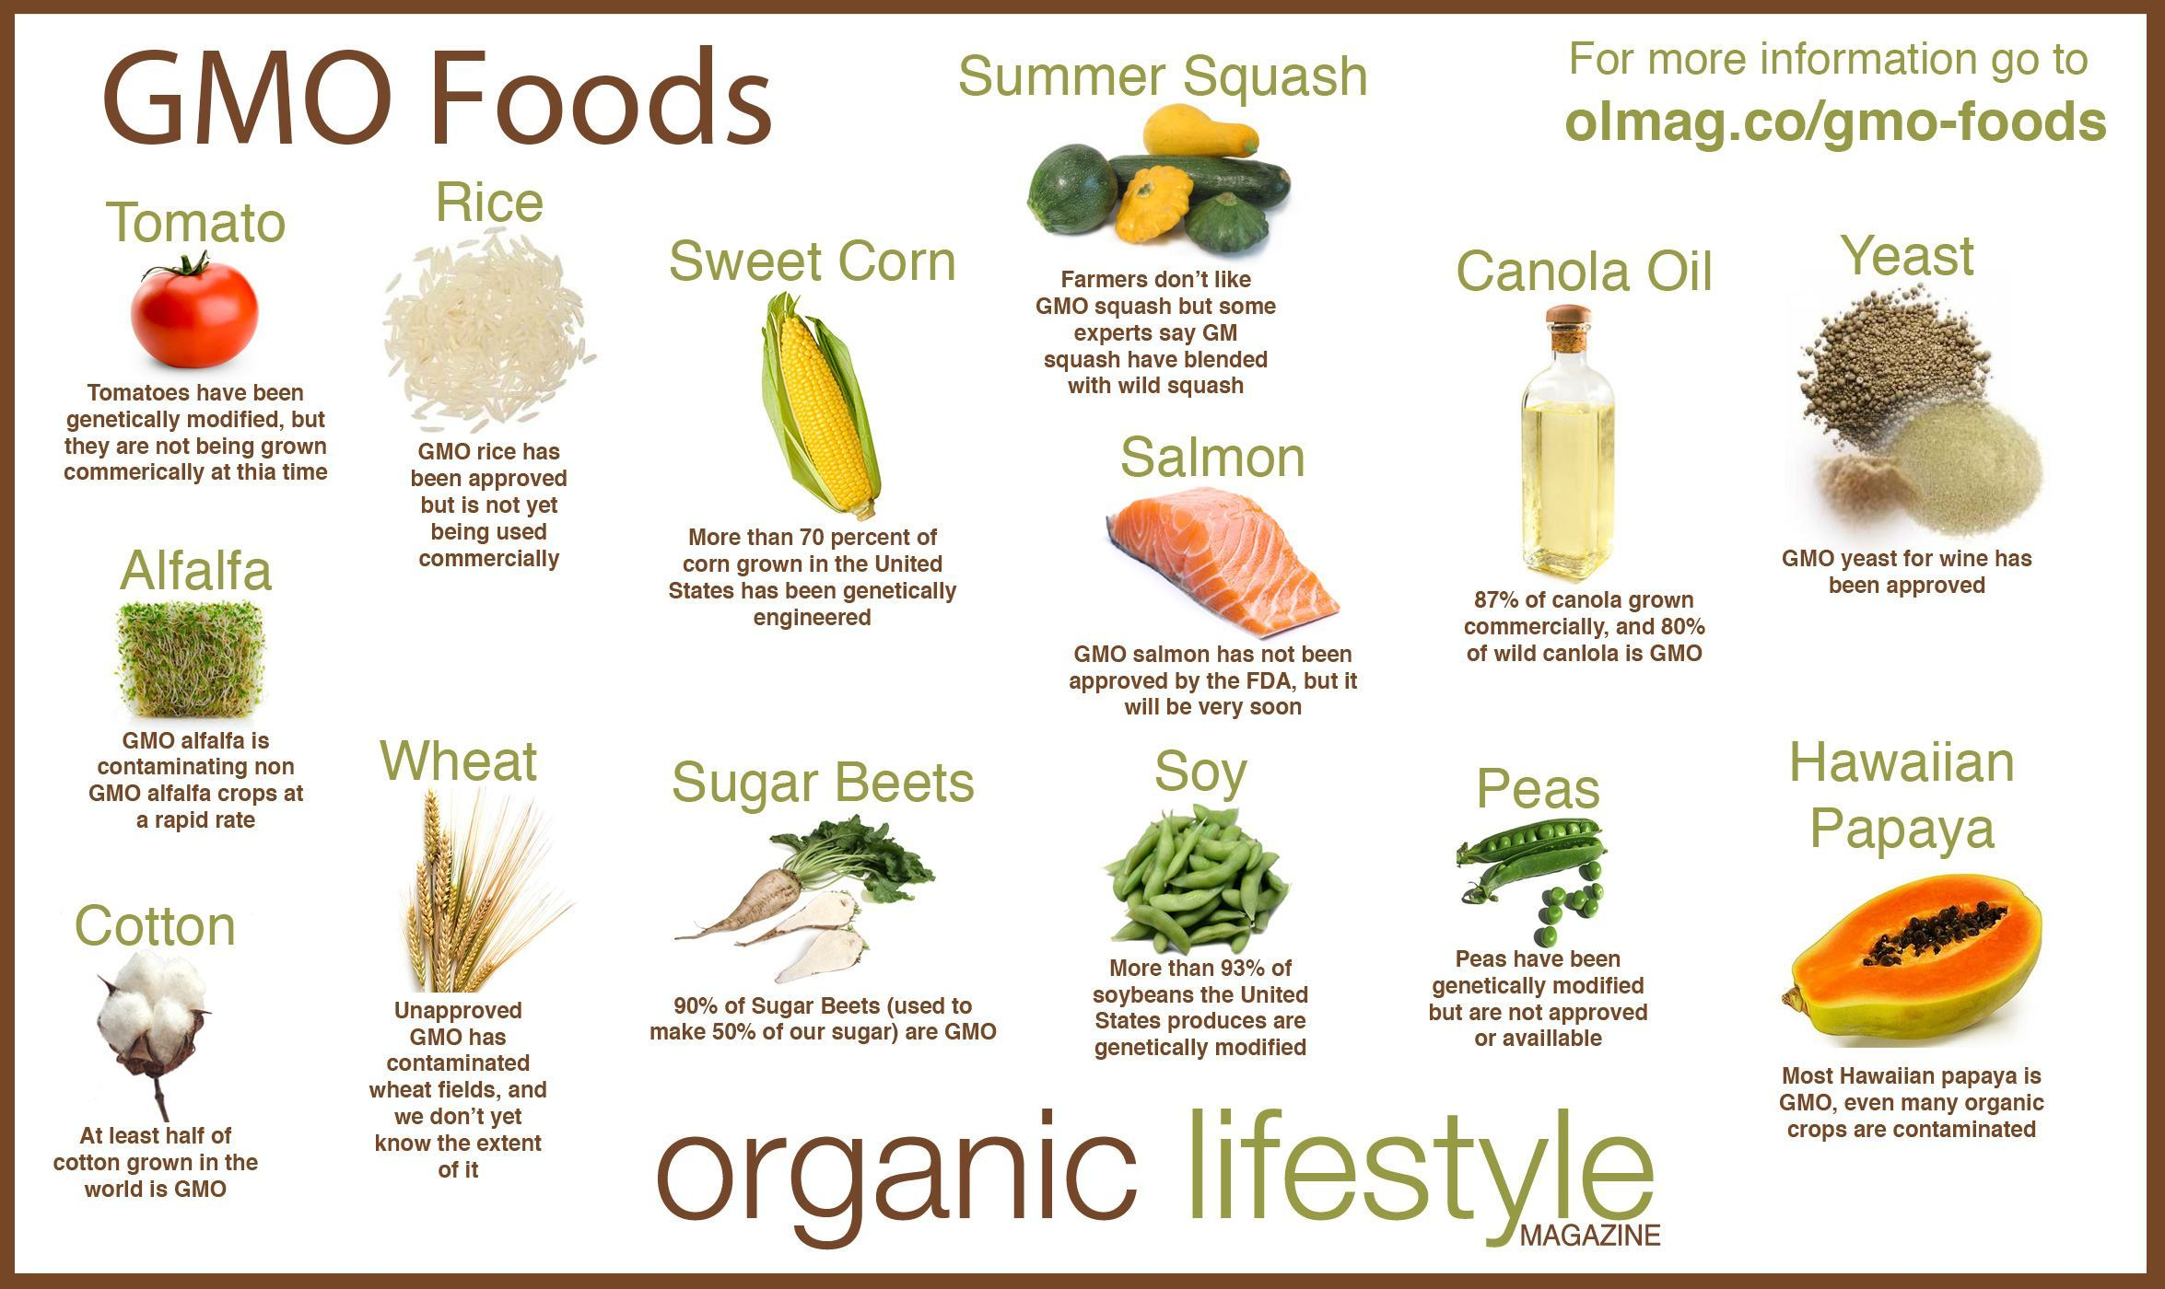


























Slide 6
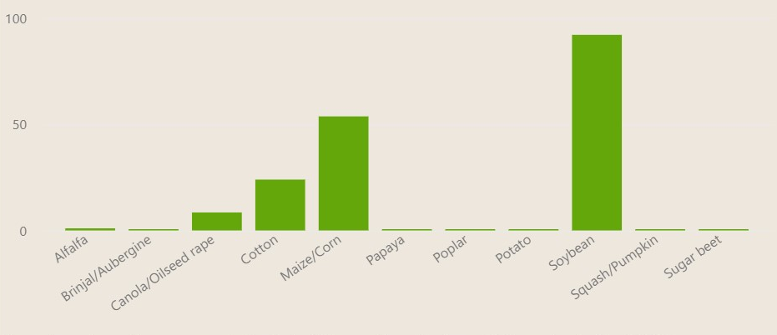
Arable land used to farm specific GM plant

Slide 7
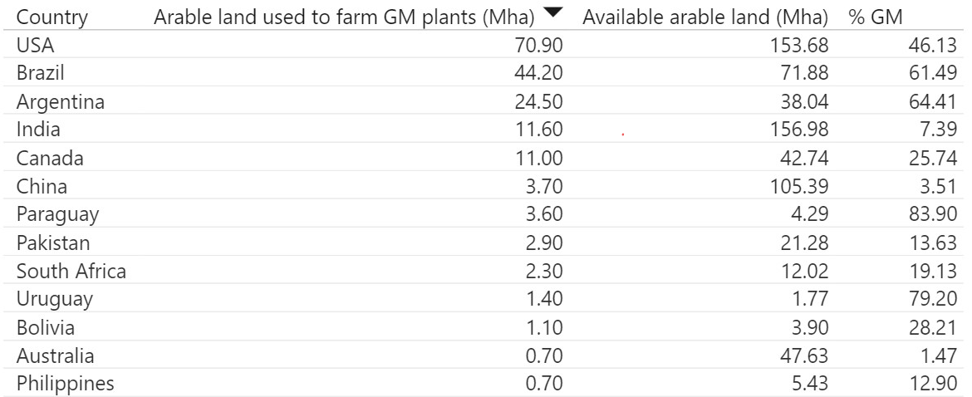
million hectares (MHa)
source: https://royalsociety.org/

Slide 8
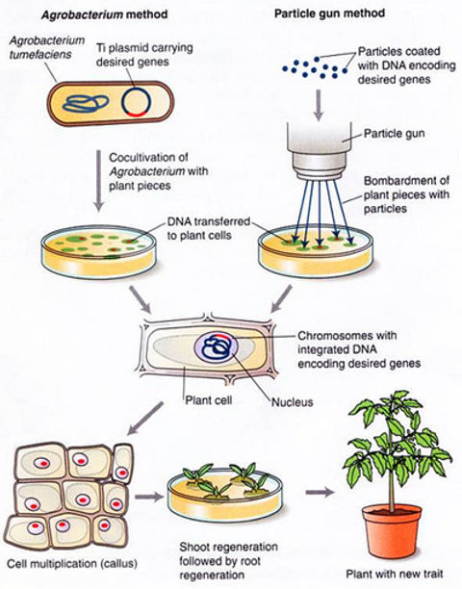
How is it done?

Slide 9
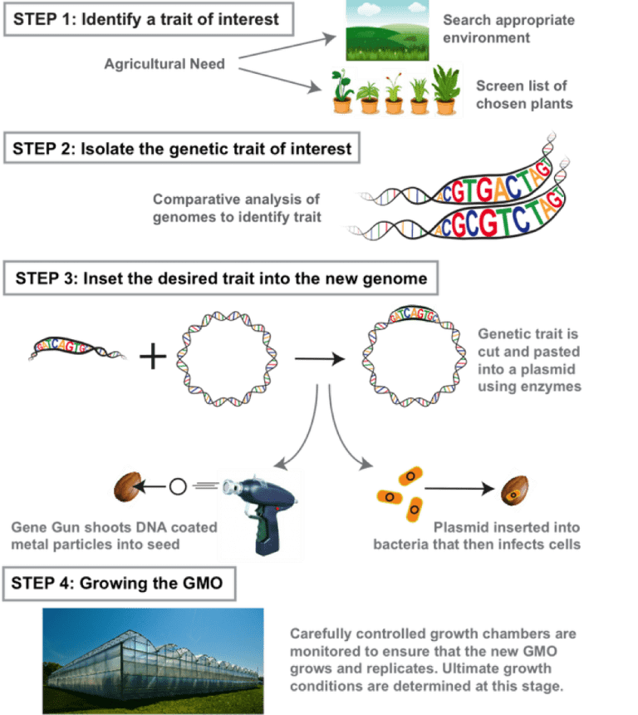
Steps

Slide 10
Advantages of GM crops
GMO foods are easier and less costly for farmers to grow, which makes them cheaper for the consumer. GMO techniques may also enhance foods’ nutrients, flavor, and appearance.

Slide 11
Disadvantages of GM crops
The main concerns around GMOs involve allergies, cancer, and environmental issues — all of which may affect the consumer. While current research suggests few risks, more long-term research is needed.

Slide 12
Conclusion
Genetically-modified foods have the potential to solve many of the world's hunger and malnutrition problems.
To help protect and preserve the environment by increasing yield and reducing reliance upon chemical pesticides and herbicides.
Yet there are many challenges ahead for government, especially in the areas of safety testing, regulation, international policy.
Many people feel that genetic engineering is the inevitable wave of the future and that we cannot afford to ignore a technology that has such enormous potential benefits.
However, we must proceed with caution to avoid causing unintended harm to human health and the environment as a result of our enthusiasm for this powerful technology.

